Slide 1

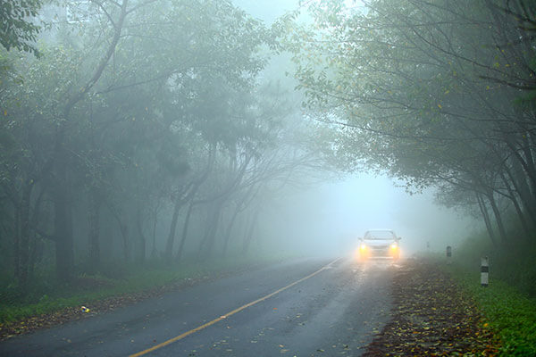

Automatic Object Detection Using Different Embedded Devices In Fog To Enhance Safety
Faculty of Engineering and Technology
An International Conference and Academic Award Ceremony On "Recent Engineering Trends in Community Development and Women Participation-II" ETCDWP-2019
PRESENTED BY:
Swati Bhattal(JV-D/12/5747)
Sweta Kumari(JV-P/17/1676)
M.Tech(CSE),final year

Slide 2
Content
Introduction
HARDWARE REQUIRED
SYSTEM DESIGN
IMPLEMENTATION OF SYSTEM
Future Work
Conclusion

Slide 3
Introduction
Basically, we are going to use three sensors that are radar sensor, sound system and vehicle speed control sensor.
These sensors will help to detect any objects automatically in hazy atmosphere like vehicle in a particular range as well as inform the driver by alarm beep and also slow down the speed of vehicles.
This feature will also help in enhancing driver applications.

Slide 4
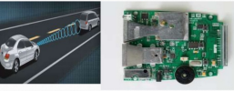
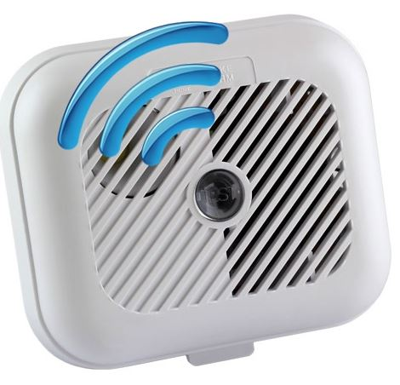
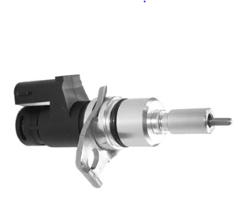
Hardware Required
Radar sensor: A radar sensor uses radio waves to determine the distance between the obstacles and the sensor.
Alarm system: A Car alarm system can be expected to do is to turn on the lights and turn them off (blink/flash), accompanied by noise, in case of object detection.
Vehicle speed sensor (VSS) : The VSS has a connection with speedometer cable to control the speed of vehicle.

Slide 5
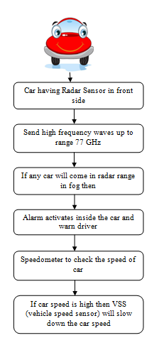
System Design

Slide 6
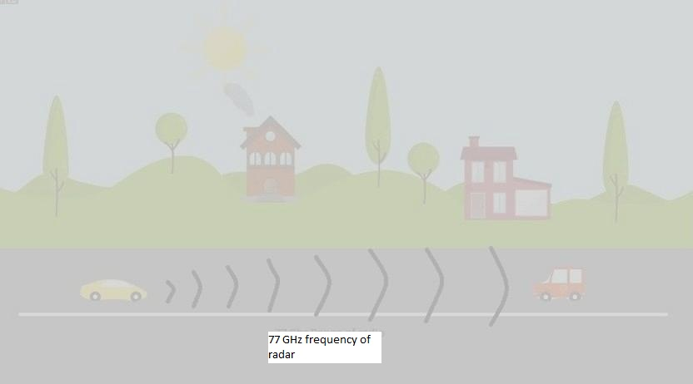
Implementation of system Step 1:

Slide 7
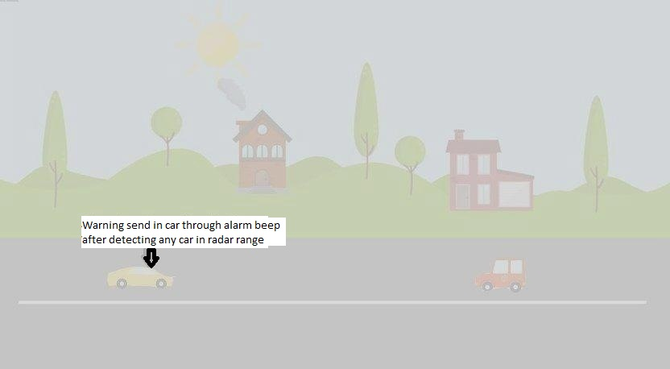
Step 2:

Slide 8
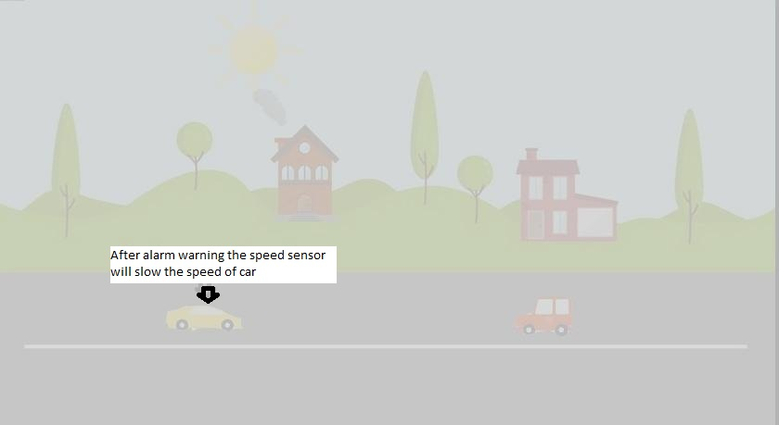
Step 3:

Slide 9

Final result

Slide 10
Future work
Currently, we have designed this system for cars to modify or enhance the advanced driver system.
In future ,we can not only use this system in any vehicle like truck, school buses and any other four wheeler in low budget but also be able to detect all characteristics of any object in the fog.
This system is basically developed to detect objects in fog and to reduce driver’s stress

Slide 11
Conclusion
we successfully developed a system with the help of radar sensors, alarm sensor and vehicle speed sensor(VSS) for fog atmosphere.
So here in this system design we are using embedded devices that is sensors to provide positive result in reducing road accidents in haziness.
we have introduced a system which will help drivers to detect vehicles automatically during winter in fog and also going to inform or warn the driver by using some sound system.

Slide 12


